Slide 1
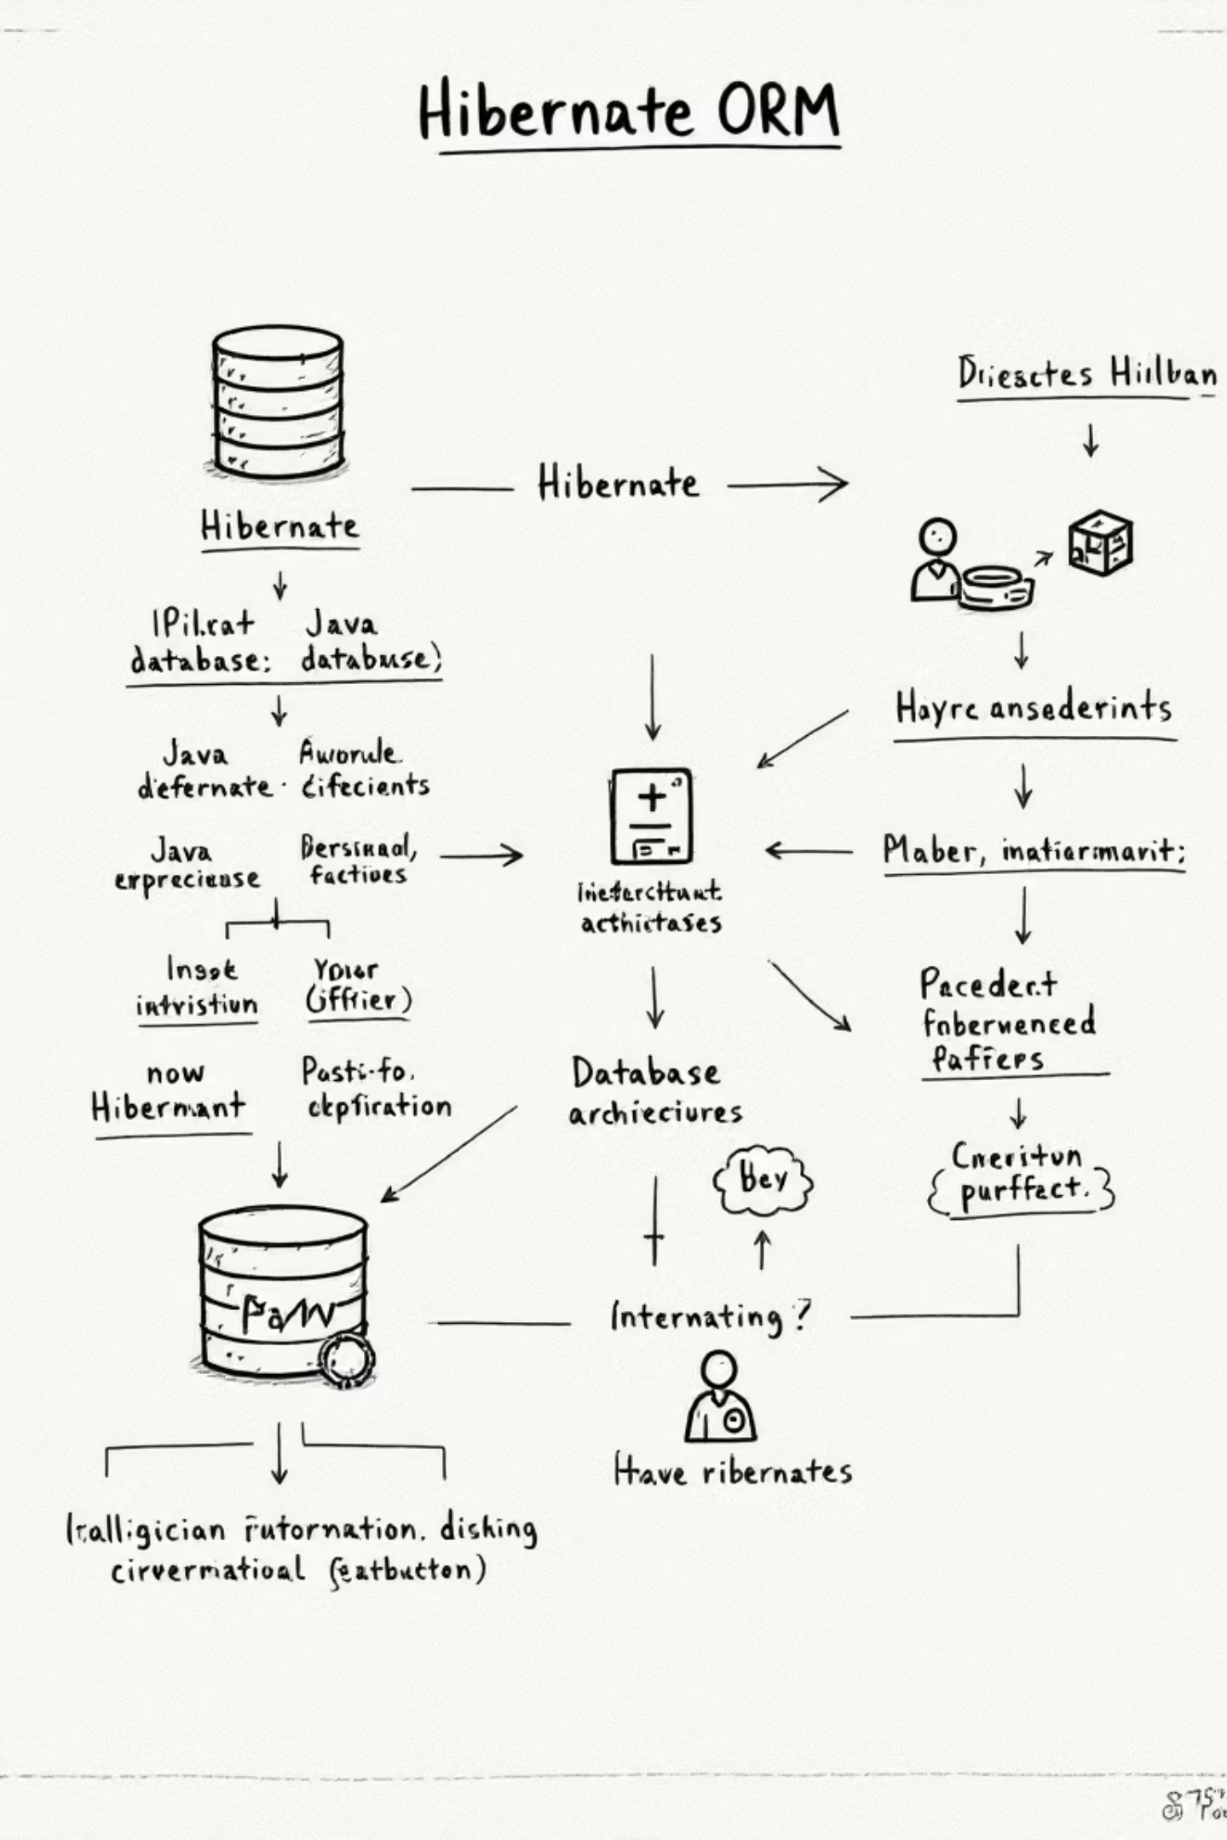
Hibernate Deep Dive: Practical Usage & Comparisons
Master Hibernate ORM's practical application, including mapping strategies, architectural decisions, and comparing JPA vs. native approaches and alternative frameworks.

Slide 2




Choosing Hibernate Mapping Types: When & Why
Entity Mapping (@Entity)
For core domain objects representing database tables. Offers full lifecycle, dirty checking, and caching for identity-tracked objects.
Embeddables (@Embeddable)
For reusable value objects (e.g., Address) without independent identity. Embedded in entities, they share parent's lifecycle and offer reuse without table overhead.
Inheritance Strategies
SINGLE_TABLE: Best performance, fewer joins, simple schema.
JOINED: Normalized schema, for large hierarchies with distinct attributes.
TABLE_PER_CLASS: For polymorphic queries with independent subclass management.
When to avoid ORM: For complex reporting, analytics, or critical performance tasks, use native SQL/DTOs to bypass object mapping overhead.

Slide 3
JPA vs Native Queries: Practical Use Cases
JPA Queries (JPQL/HQL)
Native SQL Queries
Best for: Standard CRUD & object-oriented queries within persistence context.
Best for: Database-specific features, complex joins, bulk operations, or performance-critical queries.
Key Benefits:
Use cases:
Portable
Type-safe, maintainable
DB functions (JSONB, window)
Caching & lazy loading
Complex reporting (multi-join)
Entity lifecycle integration
Query hints for performance
Bulk updates (bypasses lifecycle)
entityManager.createQuery( "FROM User WHERE status = :status").setParameter("status", "ACTIVE")
session.createNativeQuery( "SELECT * FROM users WHERE created_at > :date").setParameter("date", startDate)
Mixing Approaches: Use JPA for most operations for portability. Fall back to native SQL for vendor-specific optimizations or when ORM is a bottleneck.

Slide 4



Hibernate Without JPA: When & How
Direct Hibernate API
Advanced Features
Trade-offs
Bypass JPA for granular control over sessions, caching strategies, and advanced Hibernate-specific features.
Access Hibernate-exclusive capabilities:
Pros: Maximum flexibility, performance, full feature access
Multi-tenancy support
Custom user types
Cons: Reduced portability, increased boilerplate, steeper learning curve, tighter coupling
Session session = sessionFactory.openSession();Transaction tx = session.beginTransaction();
Advanced caching (Ehcache, Hazelcast)
Stateless sessions for batch processing
Native batch operations
Ideal Use Cases: Legacy enterprise, high-performance systems with fine-tuned caching, existing Hibernate projects, or when JPA limits necessary functionality.

Slide 5
Hibernate vs Other Java Persistence APIs
Hibernate Advantages
Spring Data JPA
Mature Ecosystem & Community
Rich Feature Set
Simplifies repository patterns;
builds on Hibernate (or other JPA providers).
Industry standard for Java ORM, with decades of production use, extensive documentation, and active community support.
Comprehensive ORM with multi-level caching, lazy loading, HQL/Criteria API, dirty checking, versioning, and complex associations.
MyBatis
SQL-centric, fine-grained control for complex
queries, requires manual mapping.
Database Portability
Write once, run on various databases (PostgreSQL, MySQL, Oracle, SQL Server) with dialect support. Seamless Spring integration.
EclipseLink
Alternative JPA reference implementation,
less popular than Hibernate.
Key Limitations
Complexity: Steep learning curve for advanced features like caching
and lazy loading.
Performance overhead: ORM abstraction adds latency vs. direct JDBC.
JOOQ
JPA constraints: Abstraction layer can limit Hibernate-specific optimizations.
Type-safe SQL construction with code generation; ideal for SQL-first development.
Bottom Line: Hibernate excels in full ORM scenarios with complex models and caching needs.
Choose MyBatis or JOOQ for fine-grained SQL control. Use simpler frameworks for microservices with basic CRUD.

